Slide 1
New Patient End-to-End Cognitive Services and Form Recognizer
Team
Dave Glover
Josh Ndemenge
Aaron Powell

Slide 2
Timelines
Drop dead date is Global AI Dev Days – Oct 1st
Allow for community train the trainer
Phase 1 complete Sept 30th
Docs complete Oct 1th

Slide 3



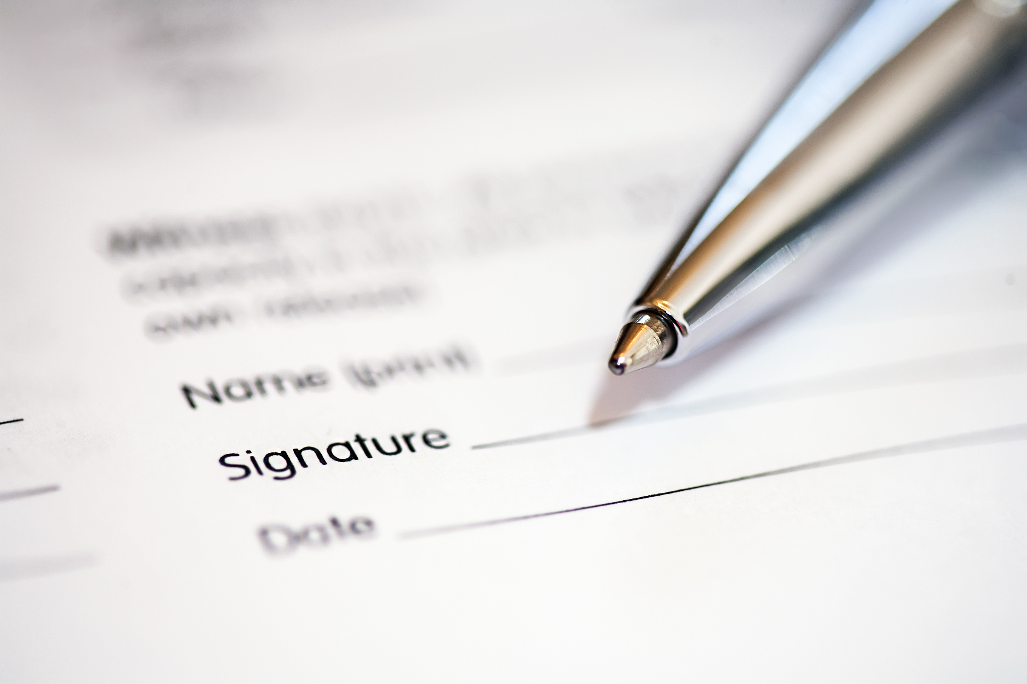




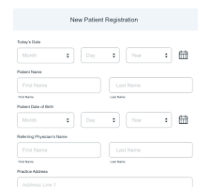
Data acquisition
Document analysis
Language Translation
Storage
Validated
3
4
5
Validate
2
1
Form Recognizer & Spell check
Drew – Admin
Alex - Nurse
Anthony - Doctor

Slide 4
Data acquisition
Storage
1
5
6
Validate and add to patient database
Validate
4
2
Form Recognizer
3
Drew – Admin
Alex - Nurse
Anthony - Doctor

Slide 5
New Patient E2E Architecture
Presentation
PWA
Mobile form capture
Web UI
Receptionist, Nurse, Doctor. Collab with deep links
Microsoft Teams
Notification Deep Link
Business
Data acquisition/Form Recognizer validation Azure Function
CRUD with Roles data access Azure Functions
Add new patient Azure Function
Language translation Logic App Orchestration
Data
Data layer – Cosmos DB

Slide 6
Azure Functions
Data acquisition Azure Durable Function HTTP Trigger (Aaron)
Post image, run Form Recognizer, perform spell check, return results back to user to confirm
CRUD data store HTTP Triggers (Josh)
Add new patient record
Get patient all
Get patient record by patient id
For Microsoft teams deep linking
Get patient record by name
Get patient record by role
Receptionist, Nurse, Doctor
Update patient record by patient ID
Called by language translation Logic App
Add patient notes by patient ID
Get all new registrations
Determined by NewRegistration field set to truw when created

Slide 7
Logic App Workflow
Pass to language translator
Update Patient DB using data add Azure Function
Microsoft Teams notify new patient added

Slide 8
Data schema
Patient
Patient ID
Family name
Given names
Date of birth
Street address, city, state, code (zip or post)
Email
Phone
Gender identity
Preferred pronoun
Emergency contact details
Name, relationship, Email, phone
Allergies and medicines and reactions
Signature
Signed date
NewRegistration
Bool set true when new rego created
Set false when admin approves new registration
Notes
Patient ID
Free text field

Slide 9
Azure Resource Group
Resource group: New-Patient-End-to-End
Subscription: 732c960a-0f46-4fbc-80ab-6909890bd1c9
Roles: All have contributor role rights
GitHub Organisation
newpatiente2e

Slide 10
Security and roles
Static Web App
Social network auth with roles

Slide 11
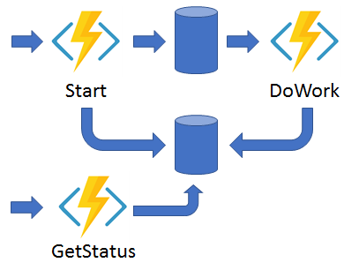
Durable functions
https://docs.microsoft.com/en-us/azure/azure-functions/durable/durable-functions-overview?tabs=csharp#async-http

